Slide 1

Note²
Application for markdown note taking
- Note Edit
- Note Management
- Note Community
119010011 CHEN Chen
119010014 CHEN Honghao
119010030 CHEN Tong
119010104 HU Yiyan

Slide 2
1
Introduction
Content
2
User
All Features of Note²…
3
Note
4
Note Community
5
Admin

Slide 3
Introduction
/01
Motivation
Components Overview
Tech Stack

Slide 4
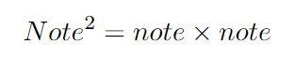
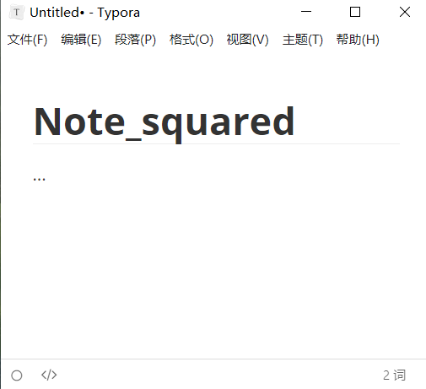
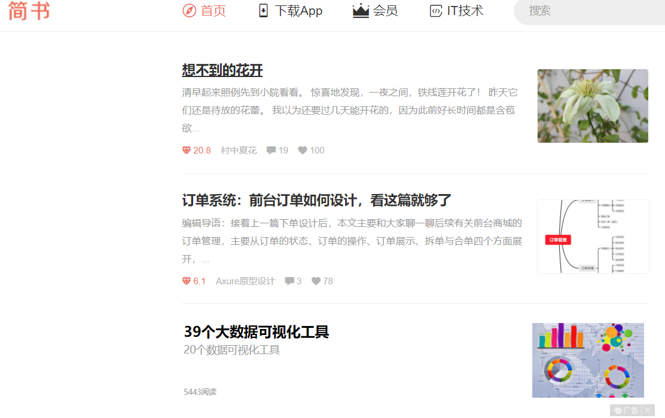
1.1. Motivation
Note taking application:
Create your own markdown notes
Note sharing platform:
Share notes with the others
Typora: A markdown editor
Jianshu: A blog sharing platform

Slide 5
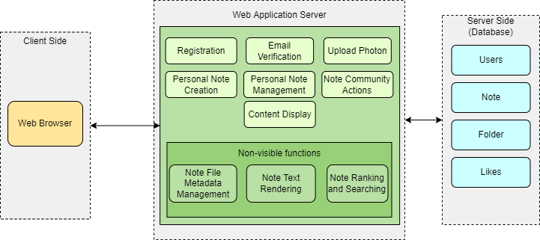
1.2. Components

Slide 6
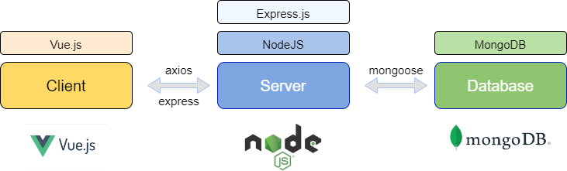
1.3. Tech Stack

Slide 7
User
/02
Email & Register
Log-in & Log-out
Edit Profile
Password Recovery

Slide 8
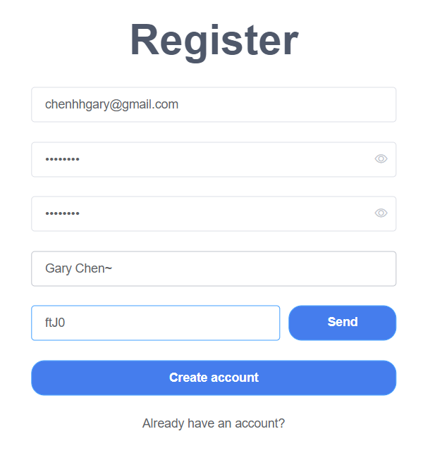
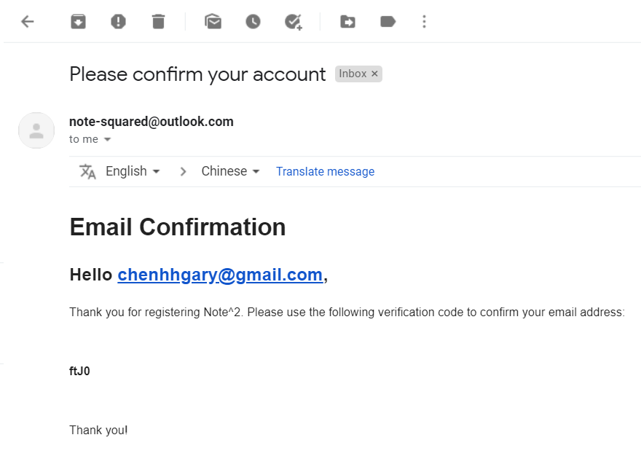
2.1. User: User register

Slide 9
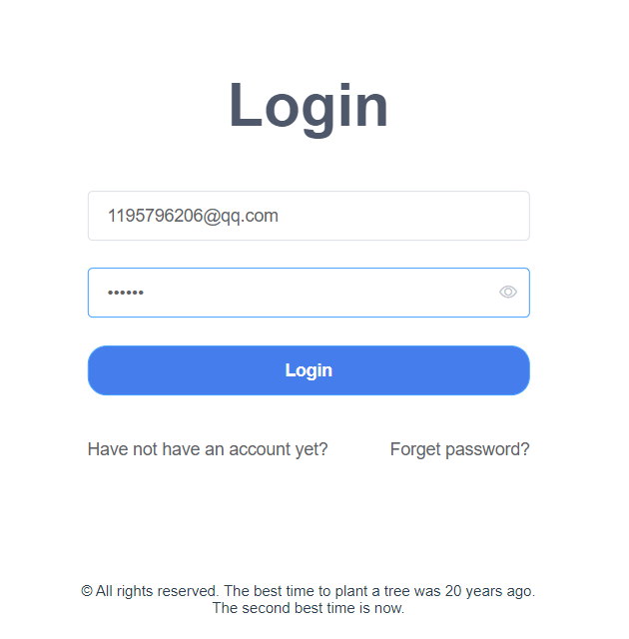
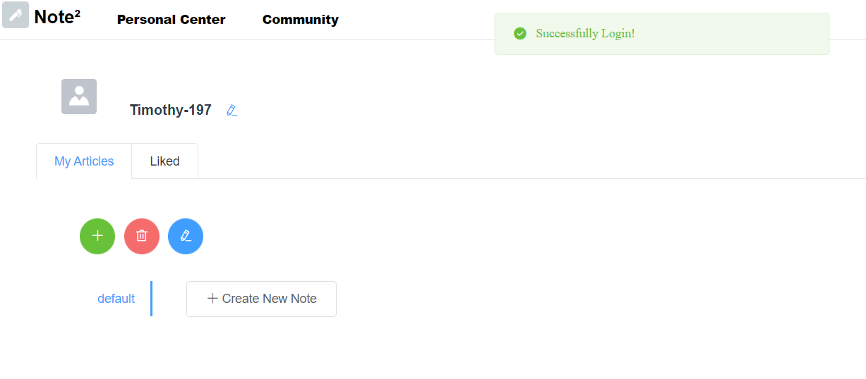
2.2. User: User Log-in & Log-out

Slide 10
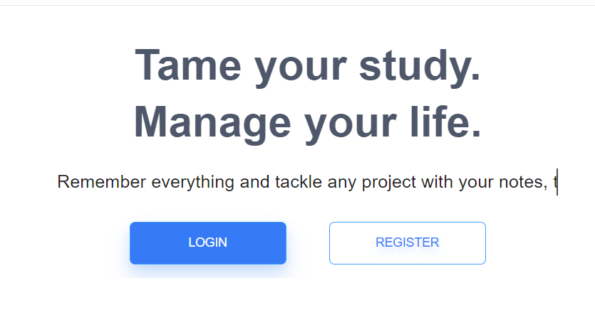
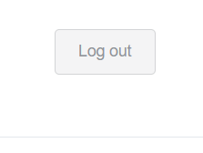
1.2. User: User Log-in & Log-out
on click

Slide 11
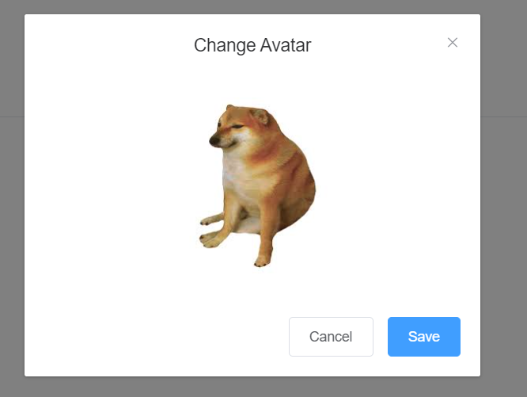
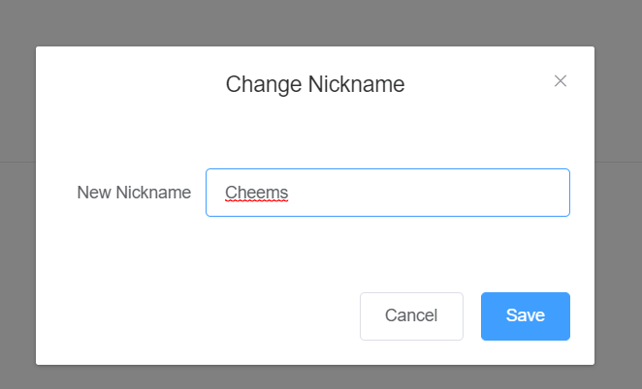
2.3. User: Edit Profile
Set Nickname
Set Avatar

Slide 12
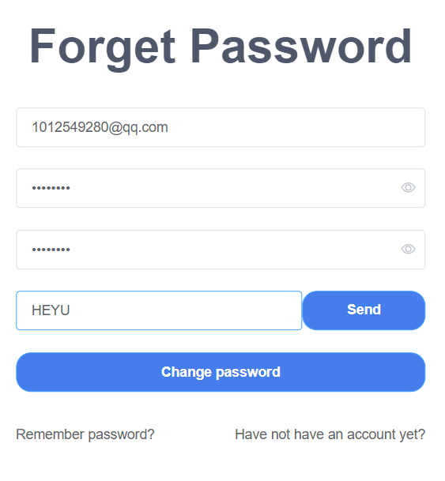
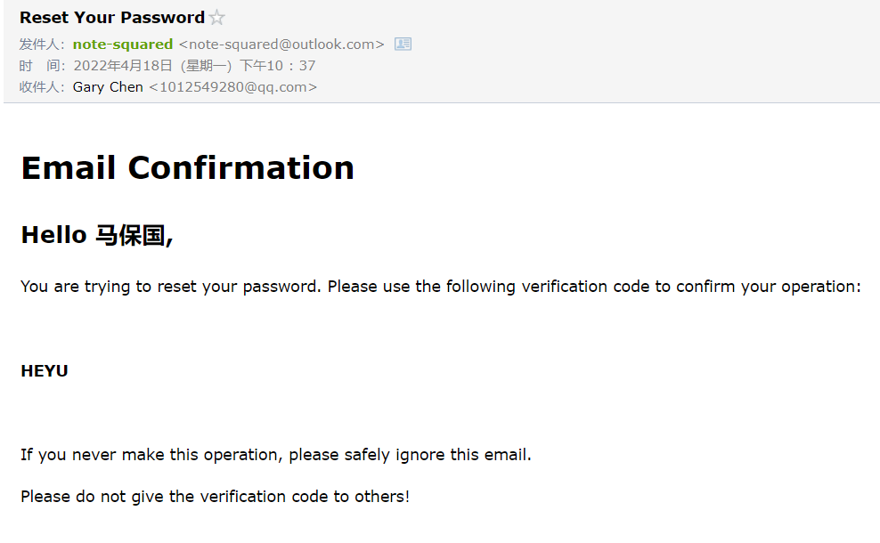
2.4. User: Password Recovery

Slide 13
Note
/03
Create / Edit Notes
Manage Note File Structure

Slide 14
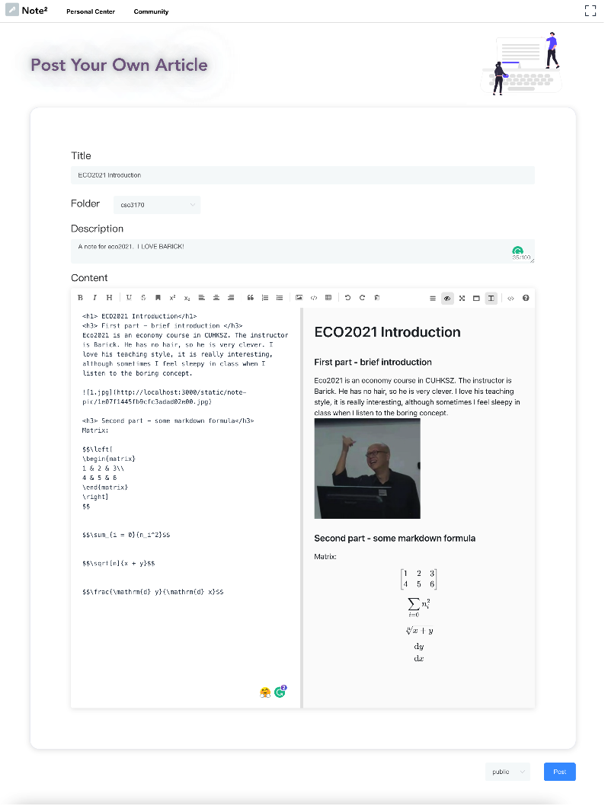
3.1. Note: Create or Edit Notes - Note features
Markdown notes
Support mark/bold/Itaic/formula/emoji
Support pictures
Public (share to the note community)/Pivate feature

Slide 15
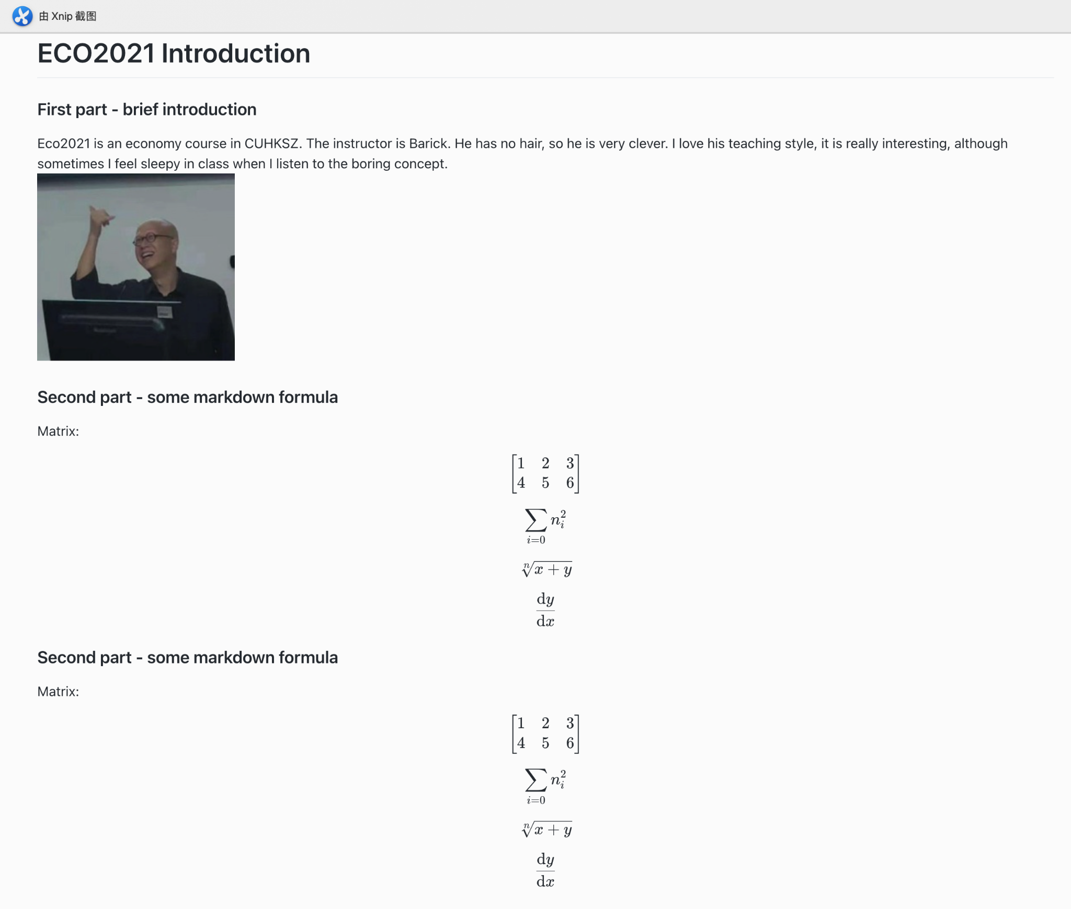
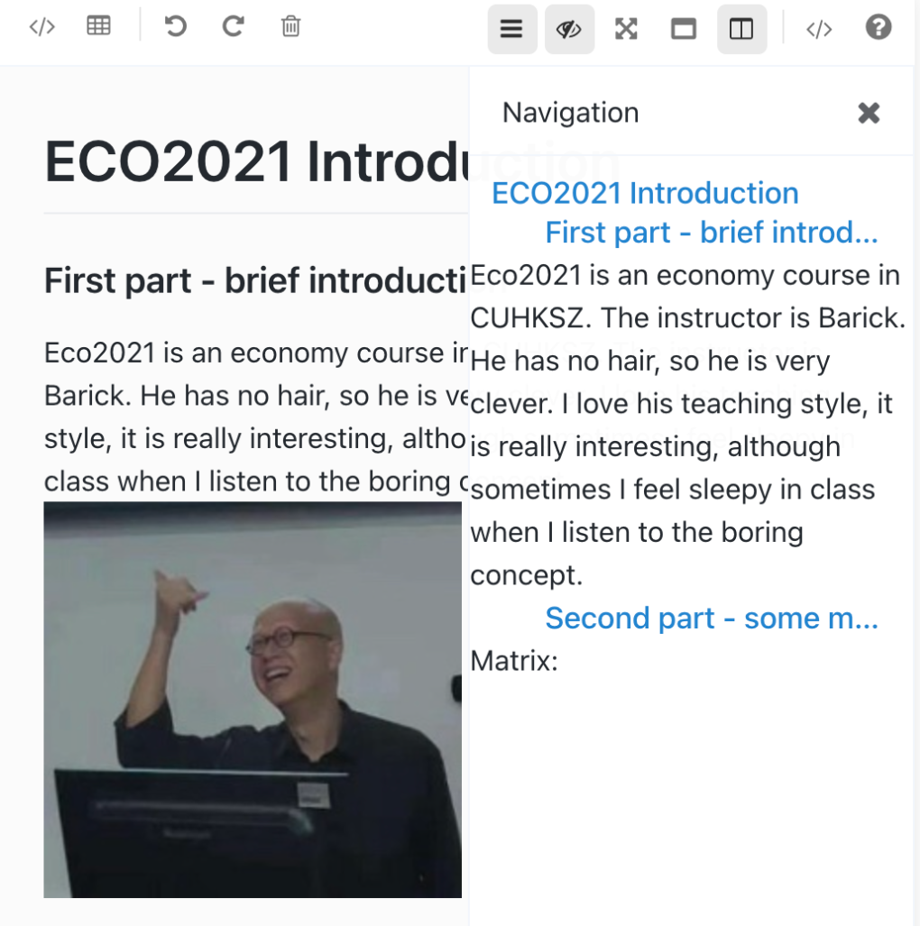
3.1. Note: Create or Edit Notes - View notes
Full screen preview
Navigation

Slide 16
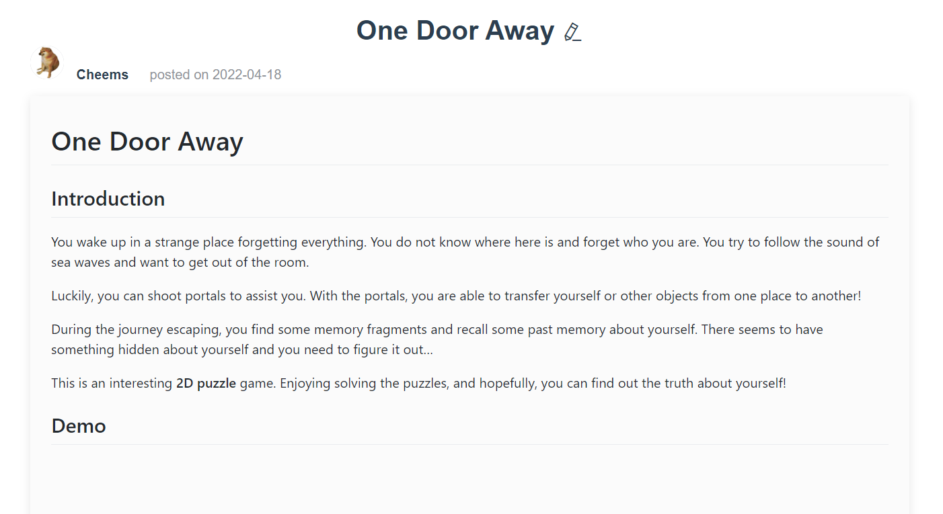
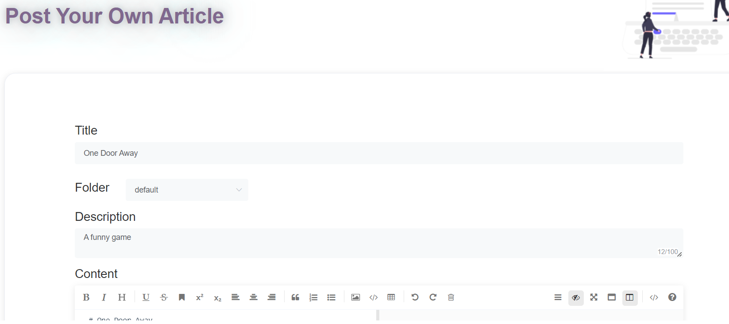
3.1. Note: Create or Edit Notes - Create
create a new note
finish creating

Slide 17
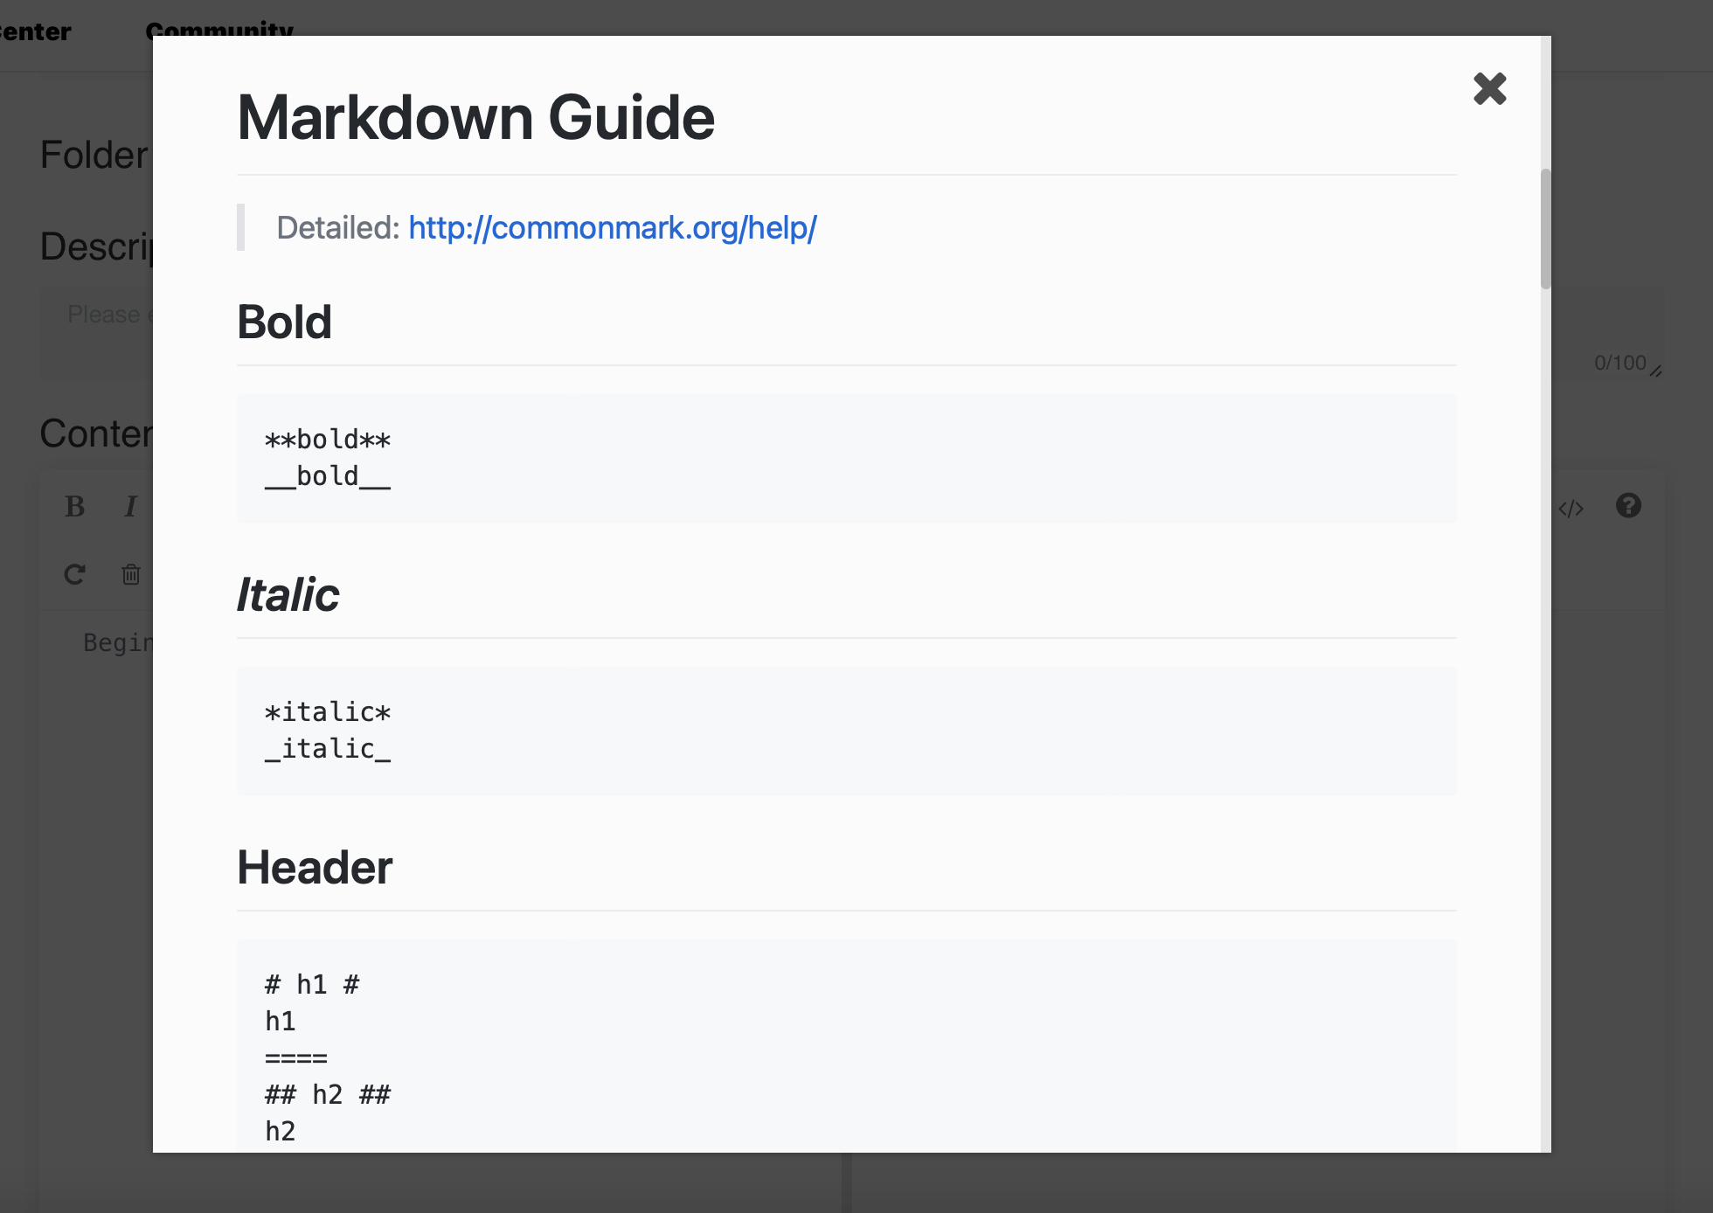
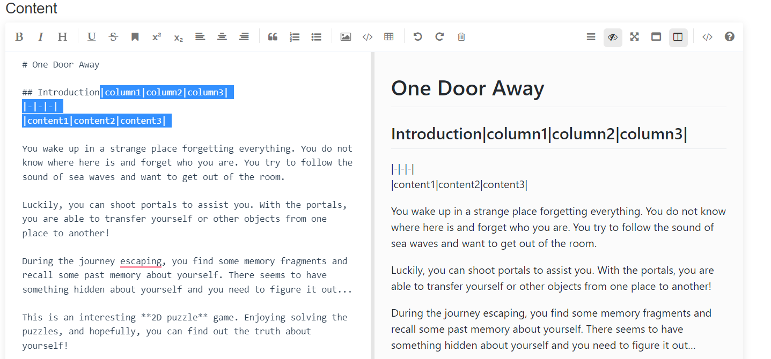
3.1. Note: Create or Edit Notes -Edit
Edit Note
A Markdown editor
Real-time Markdown text rendering
Allow inserting images, codes, equations etc.
Markdown Guide
Edit Note

Slide 18
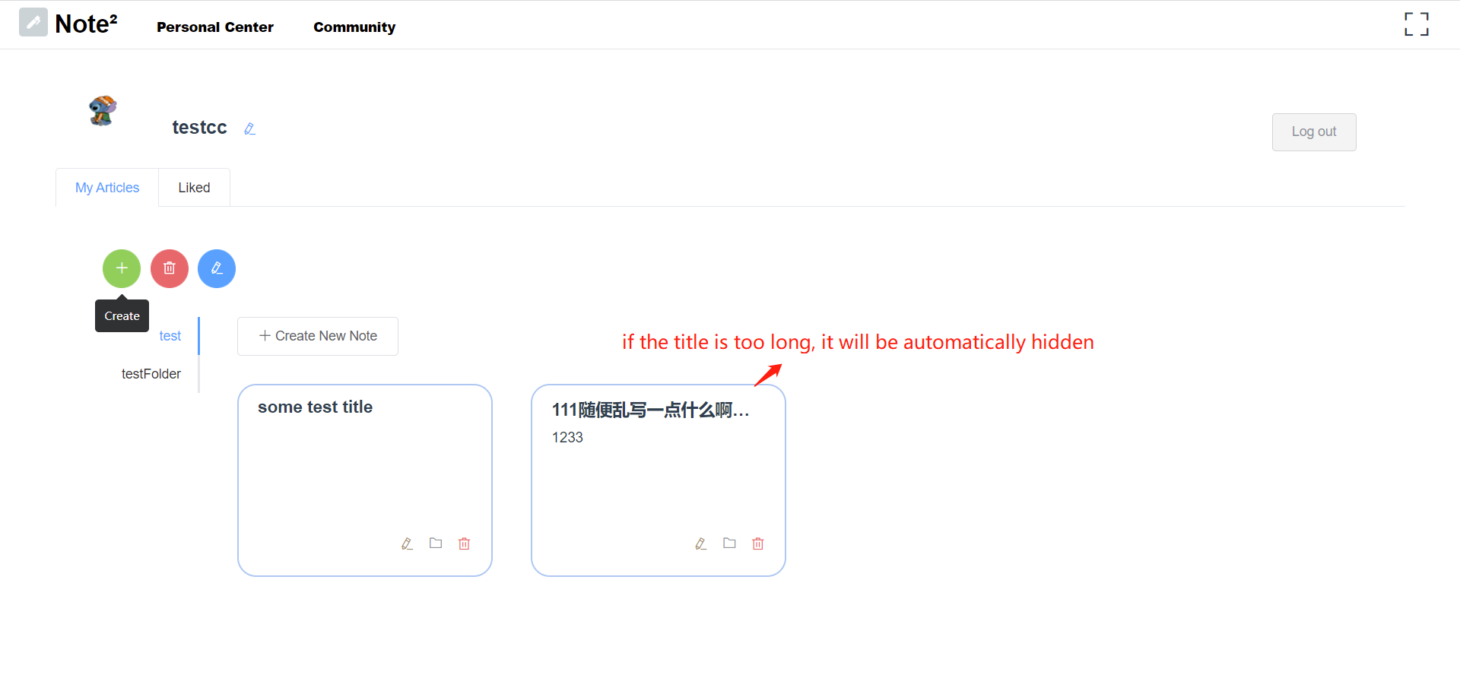
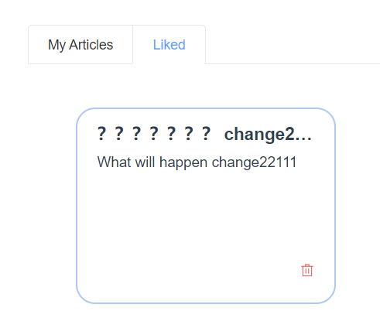
3.2. Note: Manage Note File Structure
Manage Folder & Note
Folder create/delete/rename
Note edit/move/delete
The Notes that have been marked ‘like’
Create new note in the corresponding folder
Personal Info
Change ID & set avatar

Slide 19
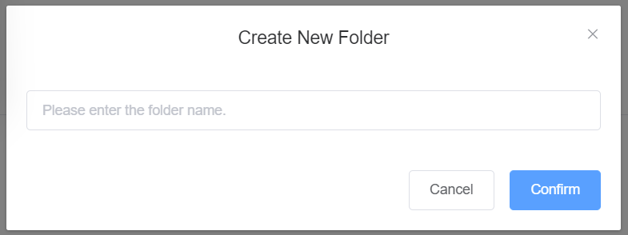
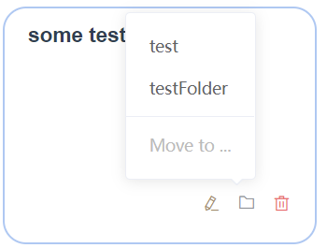
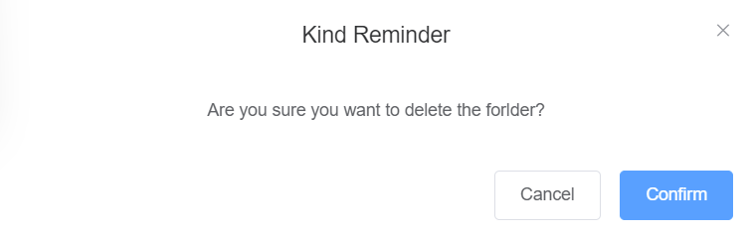
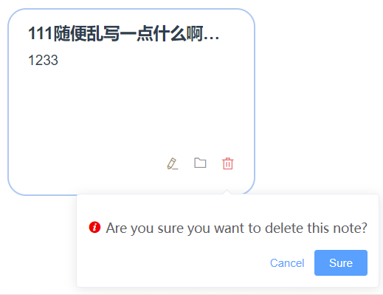
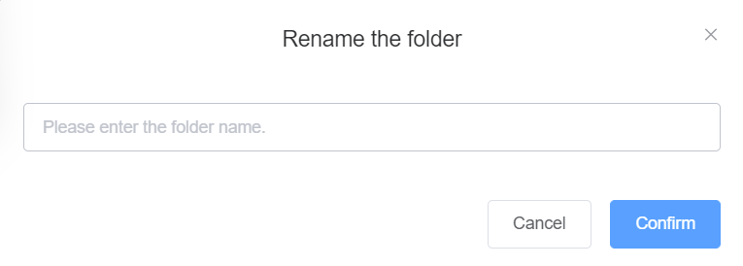
3.2. Note: Manage Note File Structure
Folder Management
Note Management

Slide 20
Note Community
/04
Articles Listing
Recommendation & Fork
Article View
Search

Slide 21
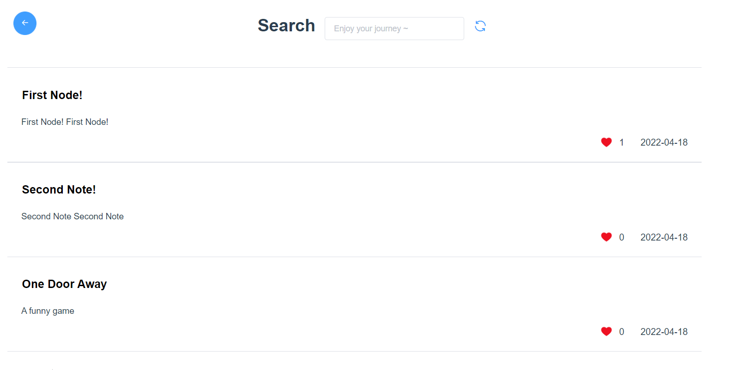
4.1. Note Community: Articles Listing
Article List
List all the public notes
Notes are ordered by a scoring algorism
View how many people like the note
Get the description of the notes

Slide 22
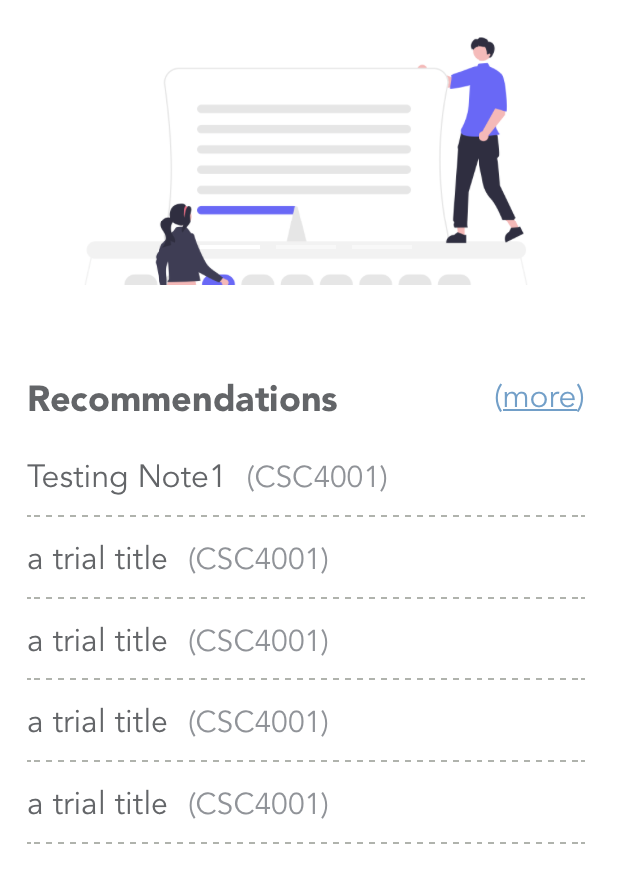
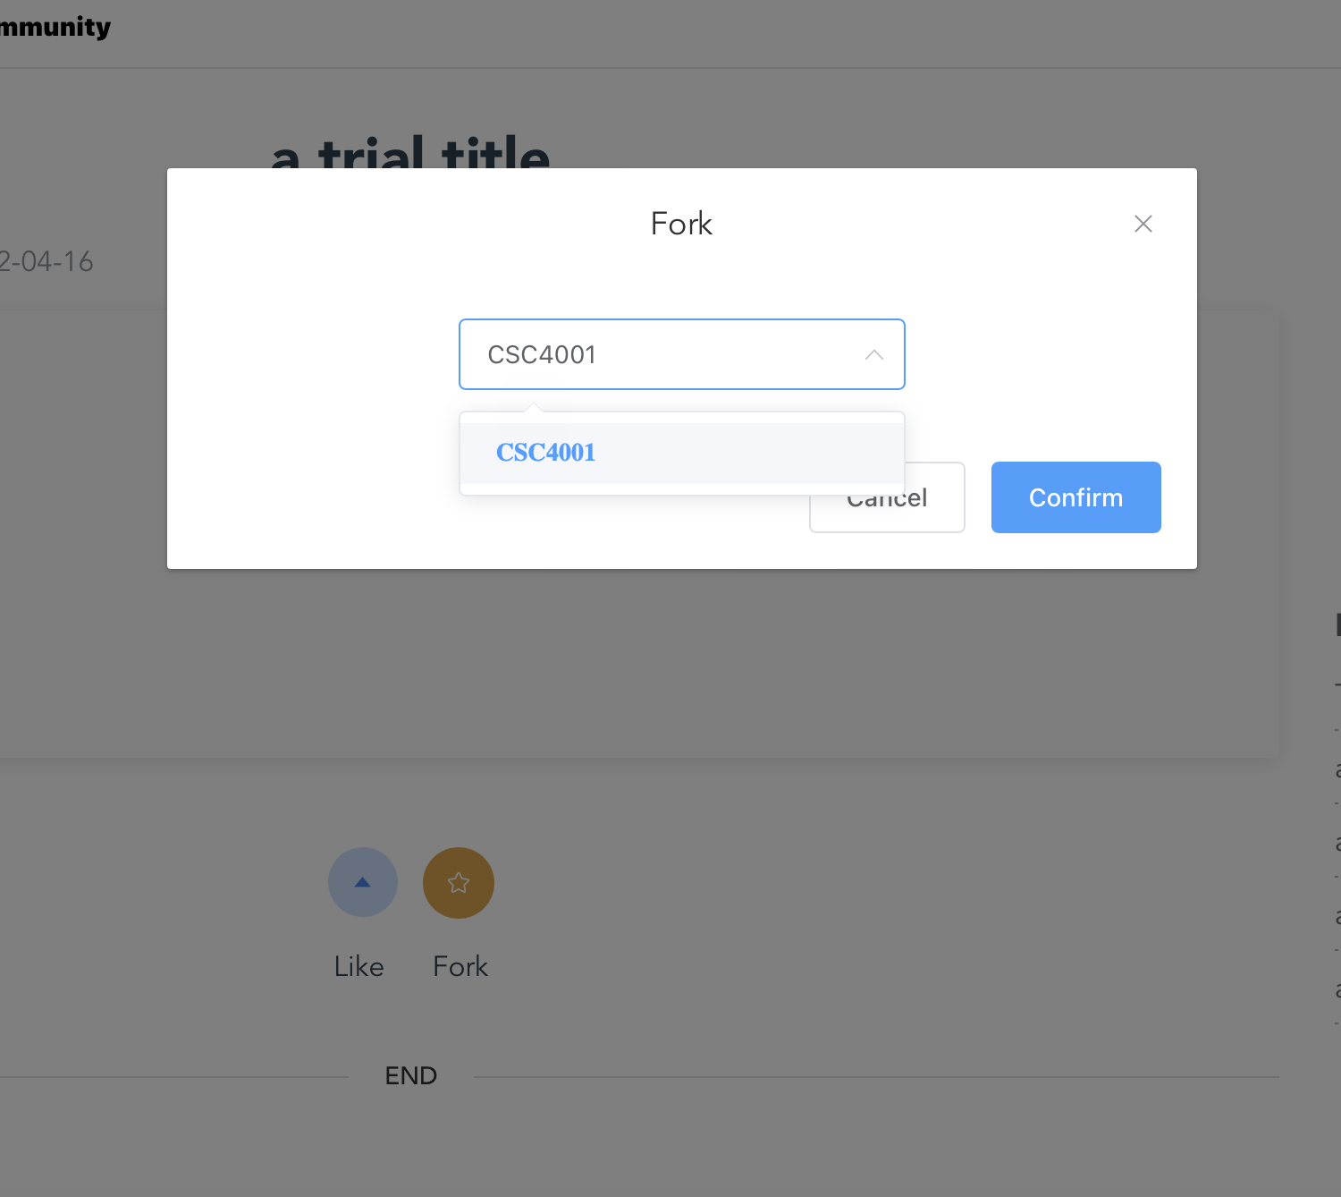
4.2. Note Community: Recommendation & Fork
Recommendation
Recommend notes basing on “scores” of public notes
Fork
Copy another user’s public note to your personal space
Fork articles
Note recommendations

Slide 23
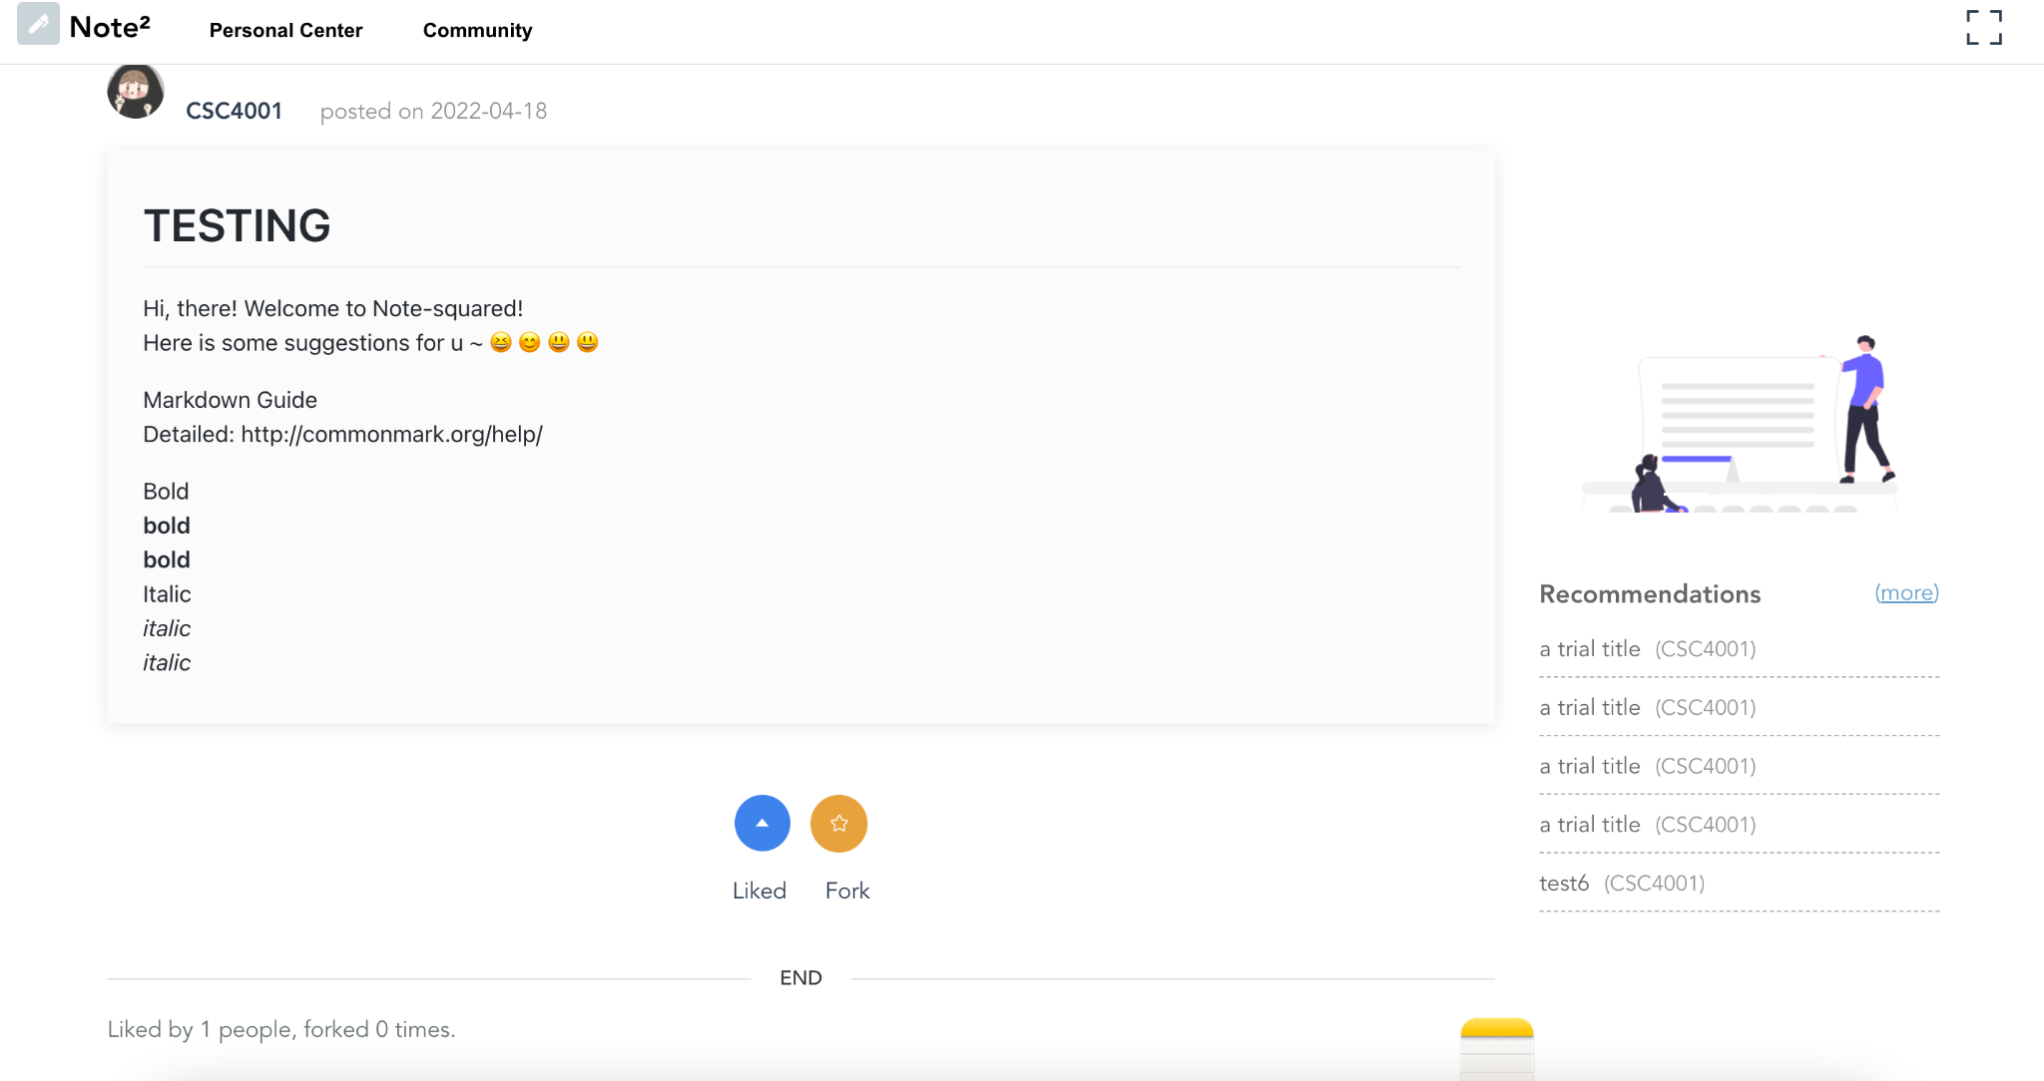
4.3. Note Community: ArticleView
View articles
View articles from the community
Thumb up other’s article
Show the likes and fork times
Responsive layout

Slide 24
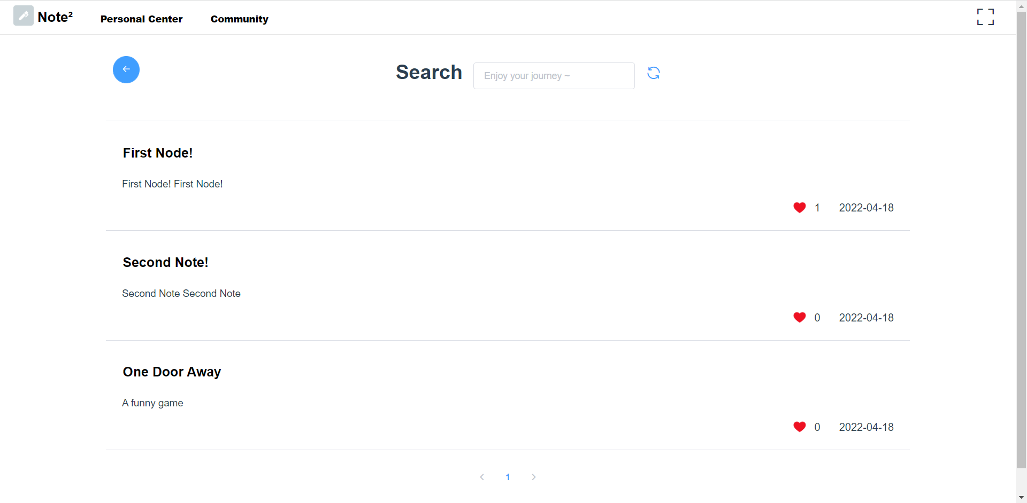
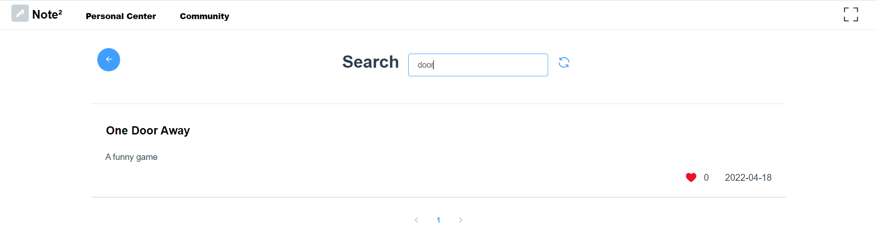
4.4. Note Community: Search
Search
You can search a public note in the community
You can self-search among your personal notes
You can public-search among all the public notes

Slide 25
Admin
/05
User List
Change Authorization
Edit User Profile
Change User Password

Slide 26
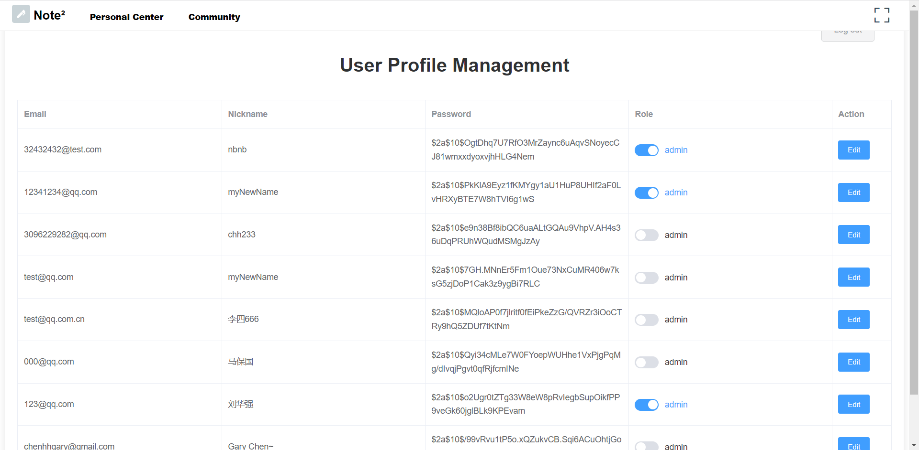
5.1. Admin: User List
Admin user can see the list of all user
The passwords of users are encrypted in the database for security

Slide 27
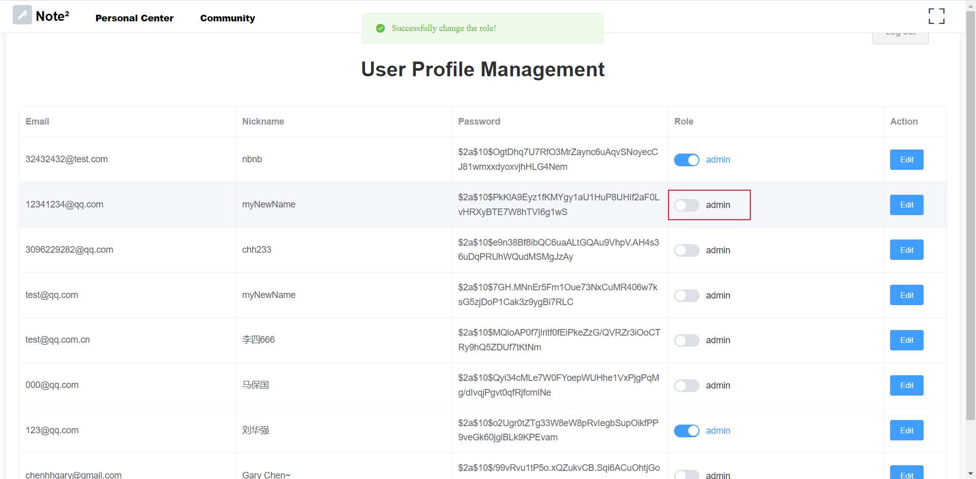
5.2. Admin: Authorization
Admin user can manage authorization of other users

Slide 28
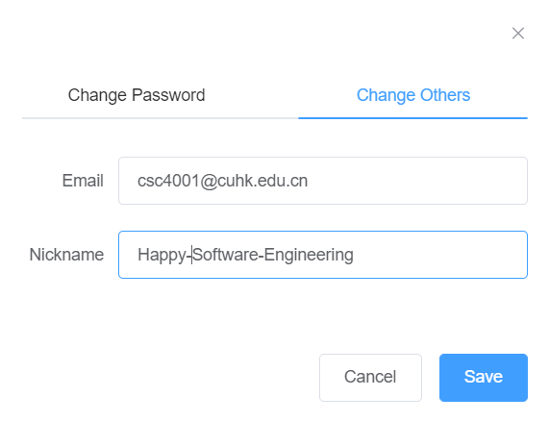
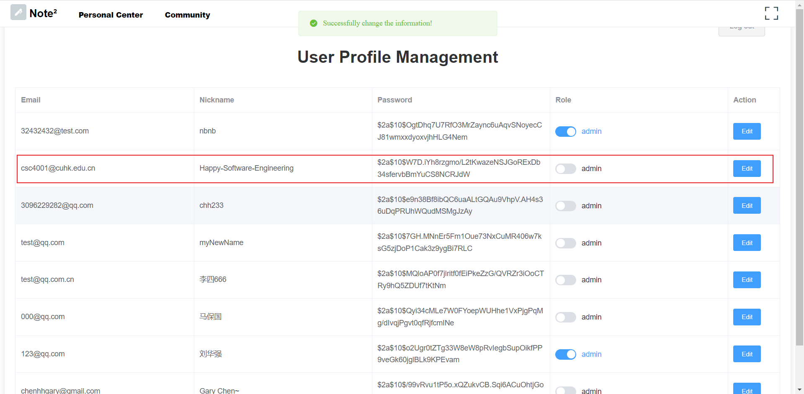
5.3. Admin: Manage User Profile
Admin user can edit profiles of other users

Slide 29
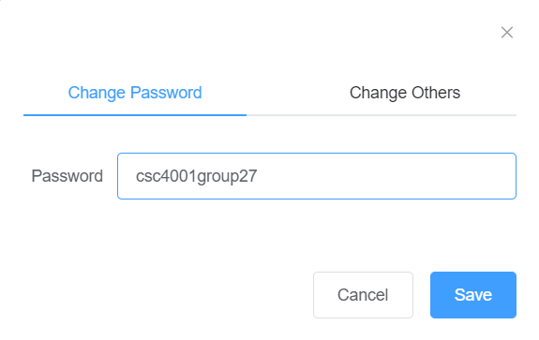
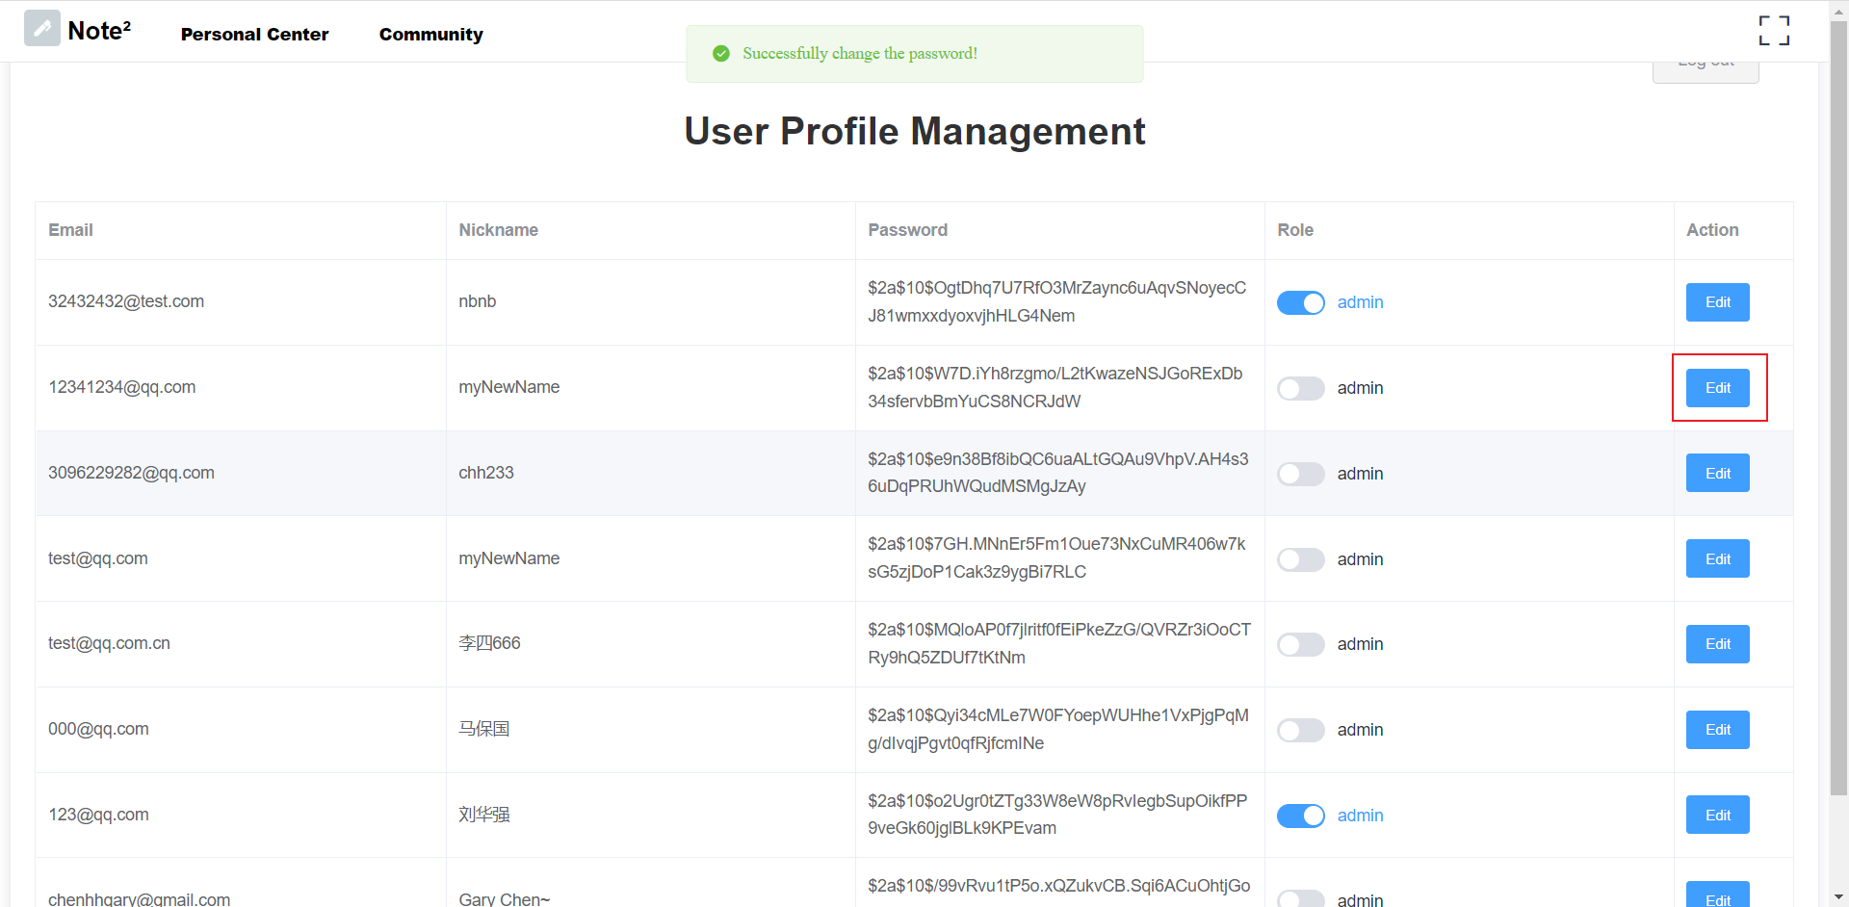
5.4. Admin: Change User Password
Admin user can reset password for other users

Slide 30
Thanks!
We have also deploy our app on a cloud server!
Welcome to play with our demo at http://note.garychen.top/
Our project will be made open-source in GitHub soon.
Give us a star if you enjoy Note²!
Repo: https://github.com/Chen-Gary/note-squared

